Slide 1
Dr Kofi A. Ababio
BSc MSc MPhil PhD
kaababs@gmail.com_x000b_+233 24 4980077

Slide 2

The Continuous Probability Distributions
Week 2

Slide 3
GOALS
Understand the difference between discrete and continuous distributions.
Compute the mean and the standard deviation for a uniform distribution.
Compute probabilities by using the uniform distribution.
List the characteristics of the normal probability distribution.
Define and calculate z values.
Determine the probability an observation is between two points on a normal probability distribution.
Determine the probability an observation is above (or below) a point on a normal probability distribution.
Use the normal probability distribution to approximate the binomial distribution.

Slide 4
Characteristics of a Continuous Probability Distribution
The probability of a particular outcome is between 0 and 1 i.e. 0 ≤ f(x) ≤ 1;
The probability distribution is defined between negative infinity (xmin) and plus infinity (xmax);
The cumulative function: ∫f(x)dx = 1
The expected value (mean) is: µ = ∫x f(x)dx
The variance: v(x) = ∫(x-µ)^2 f(x)dx

Slide 5
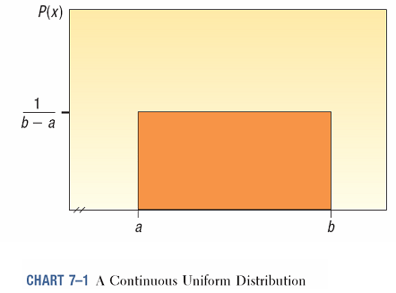
1. The Uniform Distribution
The uniform probability distribution is perhaps the simplest distribution for a continuous random variable.
This distribution is rectangular in shape and is defined by minimum and maximum values.

Slide 6
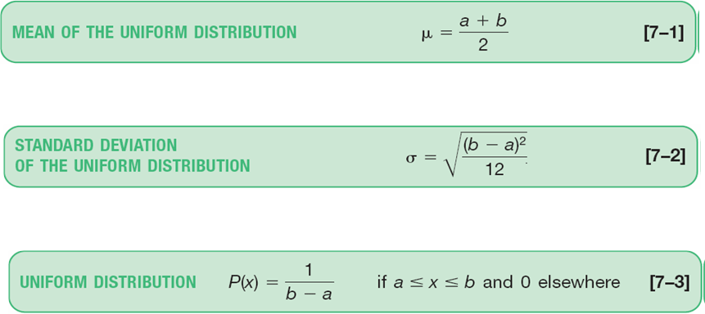
The Uniform Distribution – Mean and Standard Deviation

Slide 7
The Uniform Distribution - Example
Southwest Arizona State University provides bus service to students while they are on campus. A bus arrives at the North Main Street and College Drive stop every 30 minutes between 6 A.M. and 11 P.M. during weekdays. Students arrive at the bus stop at random times. The time that a student waits is uniformly distributed from 0 to 30 minutes.
Draw a graph of this distribution.
How long will a student “typically” have to wait for a bus? In other words what is the mean waiting time? What is the standard deviation of the waiting times?
What is the probability a student will wait more than 25 minutes?
What is the probability a student will wait between 10 and 20 minutes?

Slide 8
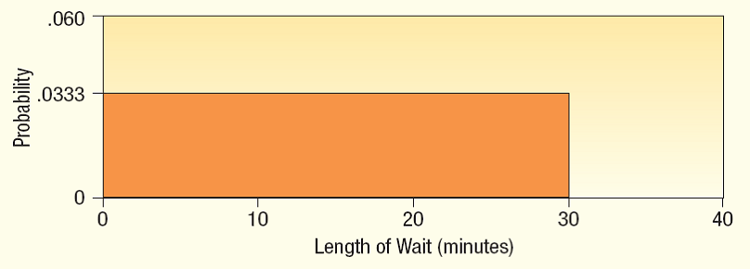
The Uniform Distribution - Example
Draw a graph of this distribution.

Slide 9
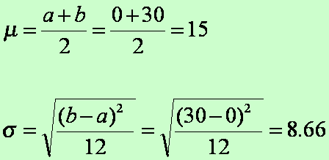
The Uniform Distribution - Example
How long will a student “typically” have to wait for a bus? In other words what is the mean waiting time? What is the standard deviation of the waiting times?

Slide 10
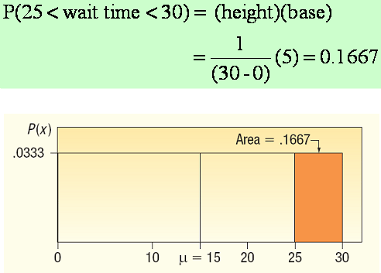
The Uniform Distribution - Example
What is the probability a student will wait more than 25 minutes?

Slide 11
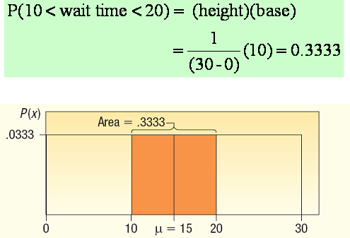
The Uniform Distribution - Example
What is the probability a student will wait between 10 and 20 minutes?

Slide 12

The Exponential Distribution
The exponential distribution has a number of useful applications. For example, we can use it to describe arrivals at a car wash or the time it takes to load a truck.

Slide 13
Exponential Probability Distribution
The exponential probability distribution is useful in describing the time it takes to complete a task.
The exponential random variables can be used to describe:
Time between vehicle arrivals at a toll booth
Time required to complete a questionnaire
Distance between major defects in a highway
In waiting line applications, the exponential distribution is often used for service times.

Slide 14
Exponential Probability Distribution
A property of the exponential distribution is that the mean and standard deviation are equal.
The exponential distribution is skewed to the right. Its skewness measure is 2.

Slide 15

Exponential Probability Distribution
Density Function
for x > 0
where: μ = expected or mean
e = 2.71828

Slide 16
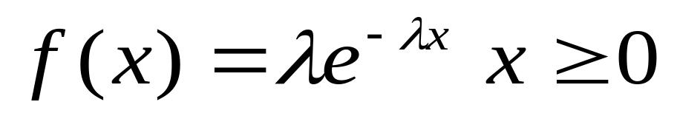
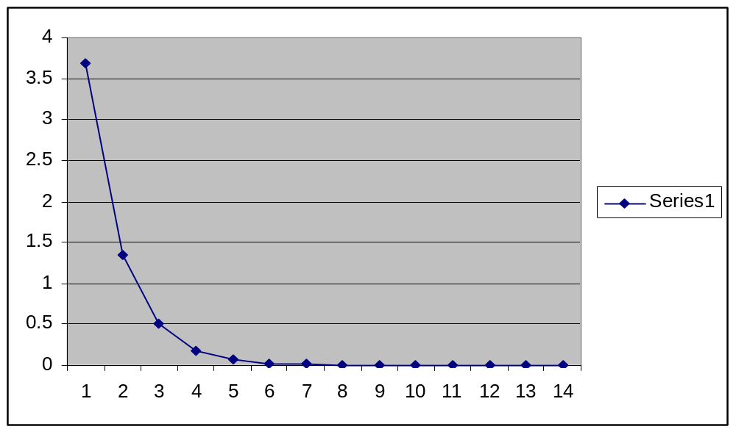
The Exponential Distribution
Probability density function

Slide 17
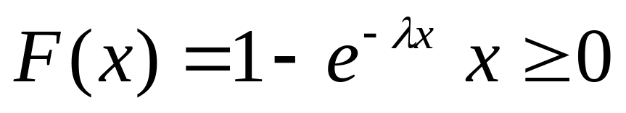
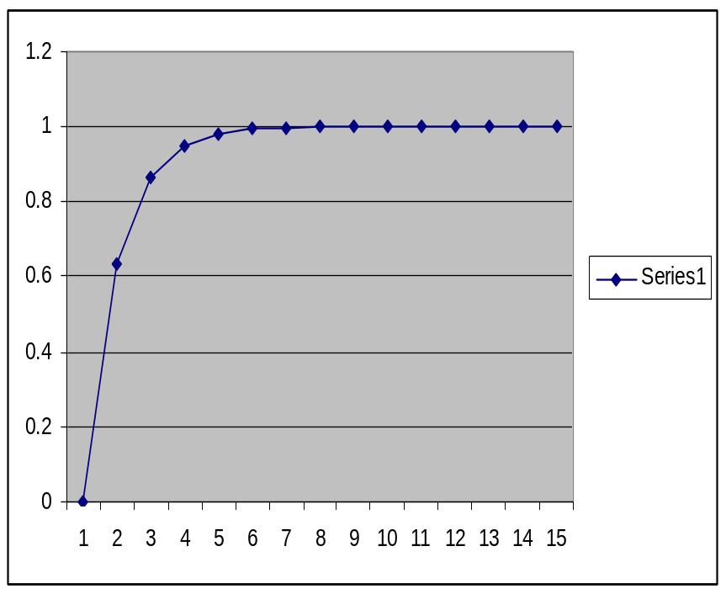
The Exponential Distribution
Cumulative Distribution function
Mean E(X) = 1/λ
Variance V(X) = 1/ λ²

Slide 18

Exponential Probability Distribution
Cumulative Probabilities
where:
x₀ = some specific value of x

Slide 19
Exponential Probability Distribution
Example: Al’s Full-Service Pump
The time between arrivals of cars at Al’s full-
service gas pump follows an exponential probability
distribution with a mean time between arrivals of 3
minutes. Al would like to know the probability that
the time between two successive arrivals will be 2
minutes or less.

Slide 20


Exponential Probability Distribution
Example: Al’s Full-Service Pump
f(x)
P(x < 2) = 1 - 2.71828^{-2/3} = 1 - 0.5134 = 0.4866
.4
.3
.2
.1
x
0 1 2 3 4 5 6 7 8 9 10
Time Between Successive Arrivals (mins.)

Slide 21
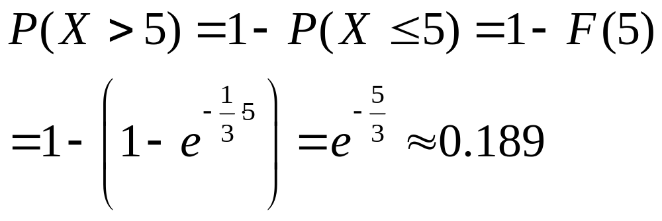
Exponential Random Variables: Applications
Suppose the wait time X for service at the post office has an exponential distribution with mean 3 minutes. If you enter the post office immediately behind another customer, what is the probability you wait over 5 minutes or more? Since E(X)=1/λ=3 minutes, then λ=1/3, so X~exponential(1/3). We want .

Slide 22
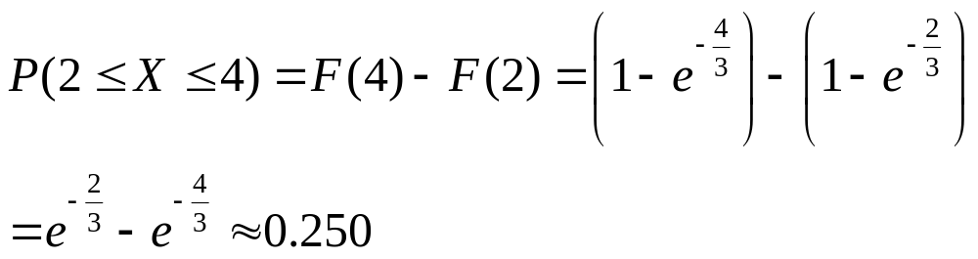
Exponential Random Variables: Applications
Under the same conditions, what is the probability of waiting between 2 and 4 minutes? Here we calculate

Slide 23
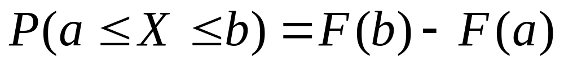
Exponential Random Variables: Applications
The trick in the previous example of calculating
is quite common. It is the reason the cdf is so useful in computing probabilities of continuous random variables. .

Slide 24
Exponential Random Variables: Applications
The article “Probabilistic Fatigue Evaluation of Riveted Railway Bridges” (J. of Bridge Engr., 2008: 237–244) suggested the exponential distribution with mean value 6 MPa as a model for the distribution of stress range in certain bridge connections.
Let’s assume that this is in fact the true model. Then
E(X) = (1/μ) = λ = 6 implies that λ = 0.1667.

Slide 25
Exponential Random Variables: Applications
The probability that stress range is at most 10 MPa is
P(X ≤ 10) = F(10 ; 0.1667)
= 1 – e^{–(0.1667)(10)}
= 1 – 0.189
= 0.811

Slide 26
Exponential Random Variables: Applications
The probability that stress range is between 5 and 10 MPa is
P (5 ≤ X ≤ 10) = F(10; 0.1667) – F(5; 0.1667)
= (1 – e ^{–1.667}) – (1 – e ^{–.8335})
= 0.246

Slide 27


Relationship between the Poisson and Exponential Distributions
The Poisson distribution
provides an appropriate description
of the number of occurrences
per interval
The exponential distribution
provides an appropriate description
of the length of the interval
between occurrences

Slide 28
2. Characteristics of a Normal
Probability Distribution
It is bell-shaped and has a single peak at the center of the distribution.
The arithmetic mean, median, and mode are equal.
The total area under the curve is 1.00; half the area under the normal curve is to the right of this center point and the other half to the left of it.
It is symmetrical about the mean.
It is asymptotic: The curve gets closer and closer to the X-axis but never actually touches it. To put it another way, the tails of the curve extend indefinitely in both directions i.e. -∞ and +∞.
The location of a normal distribution is determined by the mean, μ, the dispersion or spread of the distribution is determined by the standard deviation, σ .

Slide 29
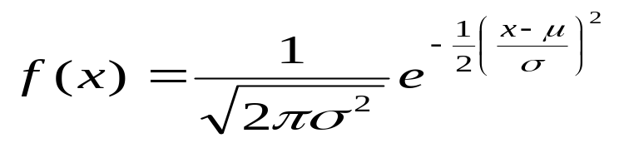
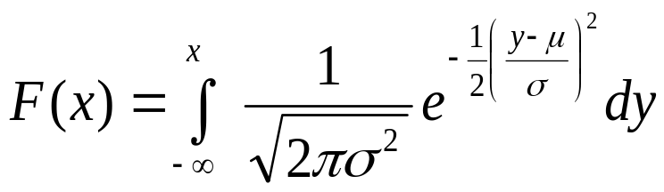
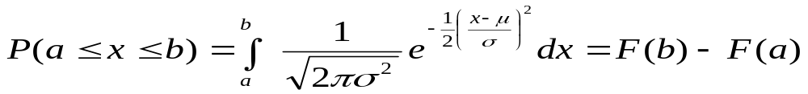
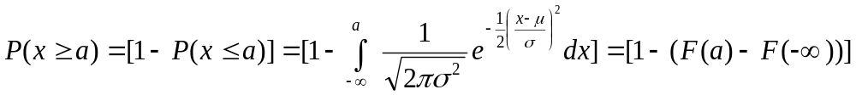
Normal Distribution - Formulas
The probability distribution is:
* The cumulative function is:

Slide 30
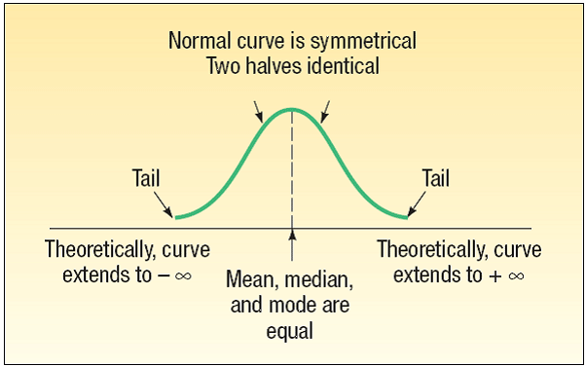
The Normal Distribution - Graphically

Slide 31
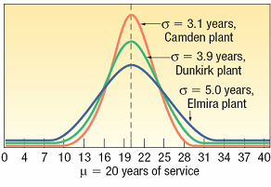
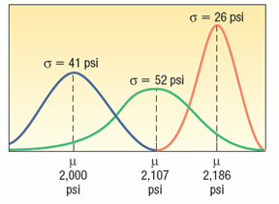
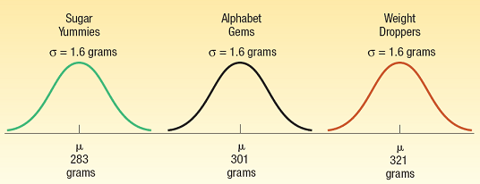
The Normal Distribution - Families

Slide 32

The Standard Normal Probability Distribution
The standard normal distribution is a normal distribution with a mean of 0 and a standard deviation of 1.
It is also called the z distribution.
A z-value is the distance between a selected value, designated X, and the population mean μ, divided by the population standard deviation, σ.
The formula is:

Slide 33
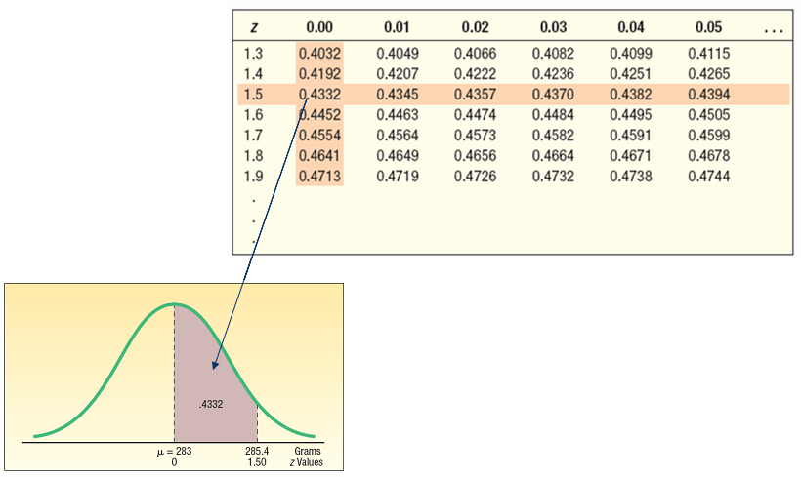
Areas Under the Normal Curve

Slide 34
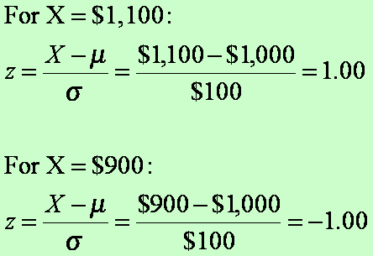
The Normal Distribution – Example
The weekly incomes of shift foremen in the glass industry follow the normal probability distribution with a mean of $1,000 and a standard deviation of $100. What is the z value for the income, let’s call it X, of a foreman who earns $1,100 per week? For a foreman who earns $900 per week?

Slide 35
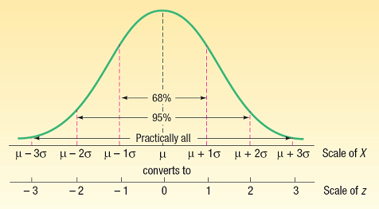
The Empirical Rule
About 68% of the area under the normal curve is within one standard deviation of the mean.
About 95% is within two standard deviations of the mean.
Practically all is within three standard deviations of the mean.

Slide 36
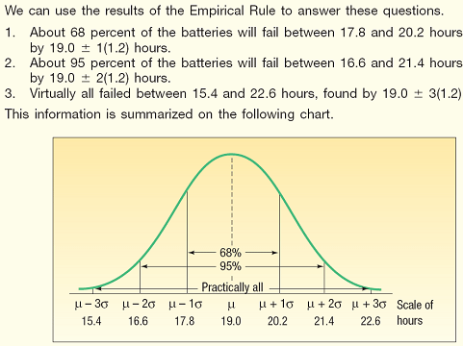
The Empirical Rule - Example
As part of its quality assurance program, the Autolite Battery Company conducts tests on battery life. For a particular D-cell alkaline battery, the mean life is 19 hours. The useful life of the battery follows a normal distribution with a standard deviation of 1.2 hours.
Answer the following questions.
About 68% of the batteries failed between what two values?
About 95% of the batteries failed between what two values?
Virtually all of the batteries failed between what two values?

Slide 37
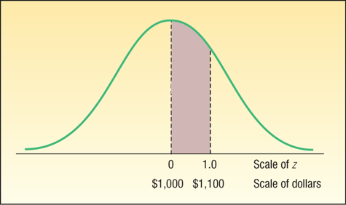
Normal Distribution – Finding Probabilities
In an earlier example we reported that the mean weekly income of a shift foreman in the glass industry is normally distributed with a mean of $1,000 and a standard deviation of $100.
What is the likelihood of selecting a foreman whose weekly income is between $1,000 and $1,100?

Slide 38
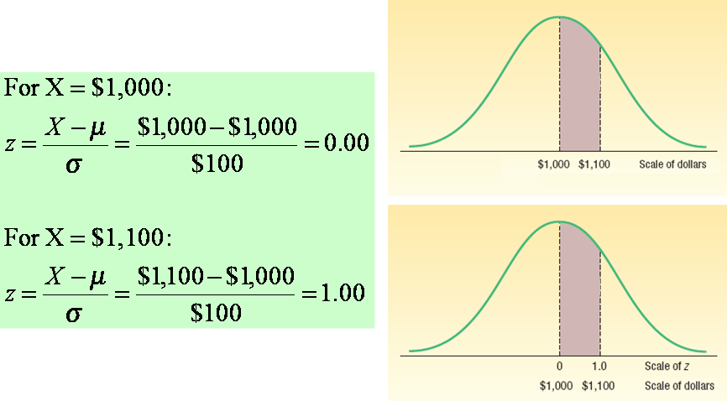

Normal Distribution – Finding Probabilities

Slide 39
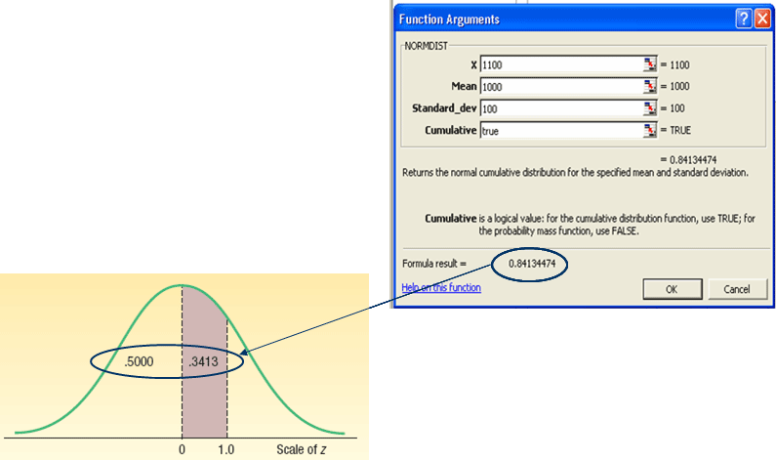
Finding Areas for Z Using Excel
The Excel function
=NORMDIST(x,Mean,Standard_dev,Cumu)
=NORMDIST(1100,1000,100,true)
generates area (probability) from
Z=1 and below

Slide 40
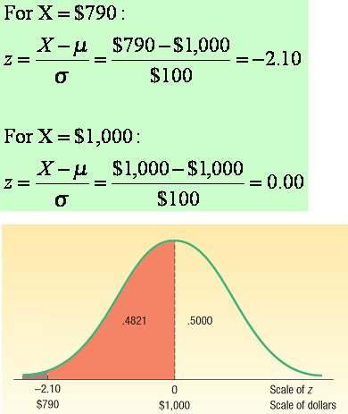
Normal Distribution – Finding Probabilities (Example 2)
Refer to the information regarding the weekly income of shift foremen in the glass industry. The distribution of weekly incomes follows the normal probability distribution with a mean of $1,000 and a standard deviation of $100.
What is the probability of selecting a shift foreman in the glass industry whose income is:
Between $790 and $1,000?

Slide 41
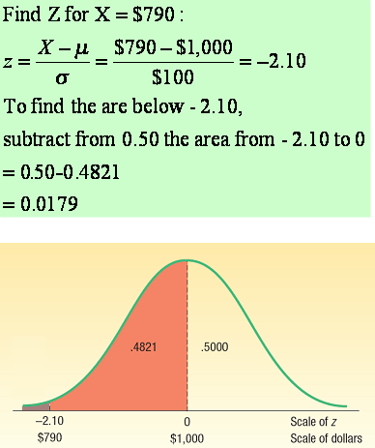
Normal Distribution – Finding Probabilities (Example 3)
Refer to the information regarding the weekly income of shift foremen in the glass industry. The distribution of weekly incomes follows the normal probability distribution with a mean of $1,000 and a standard deviation of $100.
What is the probability of selecting a shift foreman in the glass industry whose income is:
Less than $790?

Slide 42
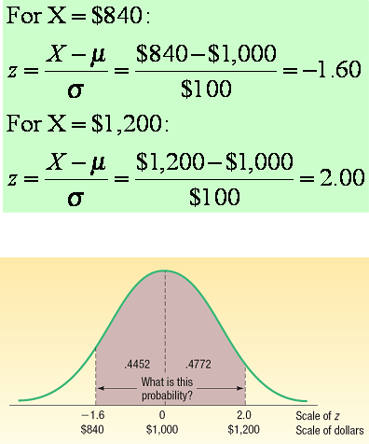
Normal Distribution – Finding Probabilities (Example 4)
Refer to the information regarding the weekly income of shift foremen in the glass industry. The distribution of weekly incomes follows the normal probability distribution with a mean of $1,000 and a standard deviation of $100.
What is the probability of selecting a shift foreman in the glass industry whose income is:
Between $840 and $1,200?

Slide 43
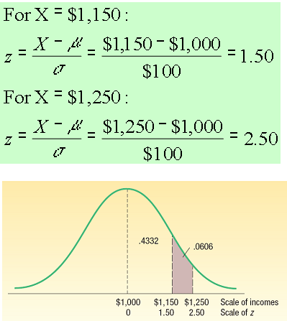
Normal Distribution – Finding Probabilities (Example 5)
Refer to the information regarding the weekly income of shift foremen in the glass industry. The distribution of weekly incomes follows the normal probability distribution with a mean of $1,000 and a standard deviation of $100.
What is the probability of selecting a shift foreman in the glass industry whose income is:
Between $1,150 and $1,250

Slide 44

Using Z in Finding X Given Area - Example
Layton Tire and Rubber Company wishes to set a minimum mileage guarantee on its new MX100 tire. Tests reveal the mean mileage is 67,900 with a standard deviation of 2,050 miles and that the distribution of miles follows the normal probability distribution. It wants to set the minimum guaranteed mileage so that no more than 4 percent of the tires will have to be replaced. What minimum guaranteed mileage should Layton announce?

Slide 45
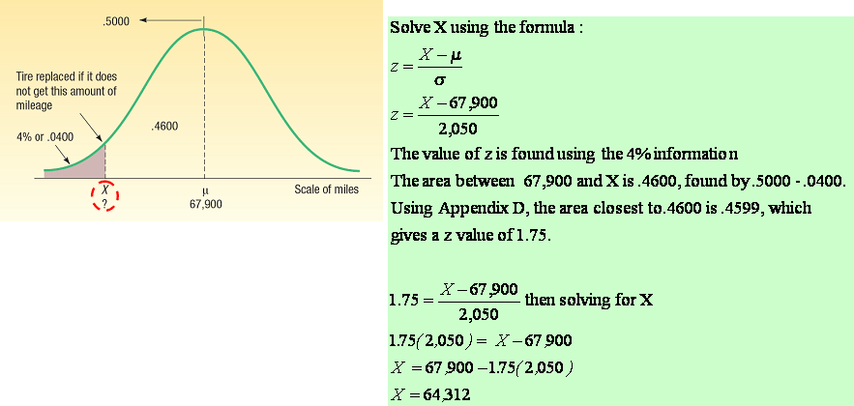
Using Z in Finding X Given Area - Example

Slide 46
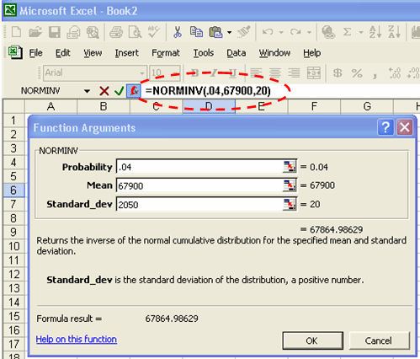
Using Z in Finding X Given Area - Excel

Slide 47
Normal Approximation to the Binomial
The normal distribution (a continuous distribution) yields a good approximation of the binomial distribution (a discrete distribution) for large values of n.
The normal probability distribution is generally a good approximation to the binomial probability distribution when nπ and n(1-π ) are both greater than 5.

Slide 48
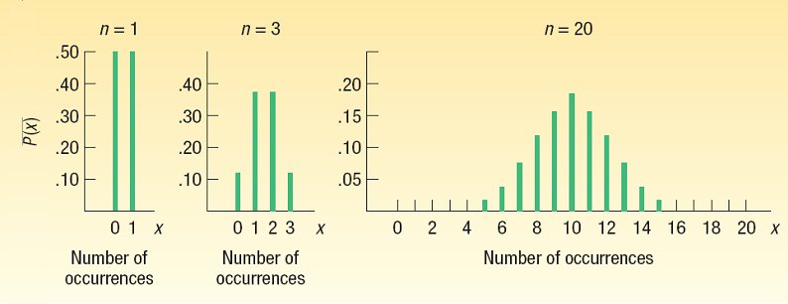
Normal Approximation to the Binomial
Using the normal distribution (a continuous distribution) as a substitute for a binomial distribution (a discrete distribution) for large values of n seems reasonable because, as n increases, a binomial distribution gets closer and closer to a normal distribution.

Slide 49
Continuity Correction Factor
The value 0.5 subtracted or added, depending on the problem, to a selected value when a binomial probability distribution (a discrete probability distribution) is being approximated by a continuous probability distribution (the normal distribution).

Slide 50
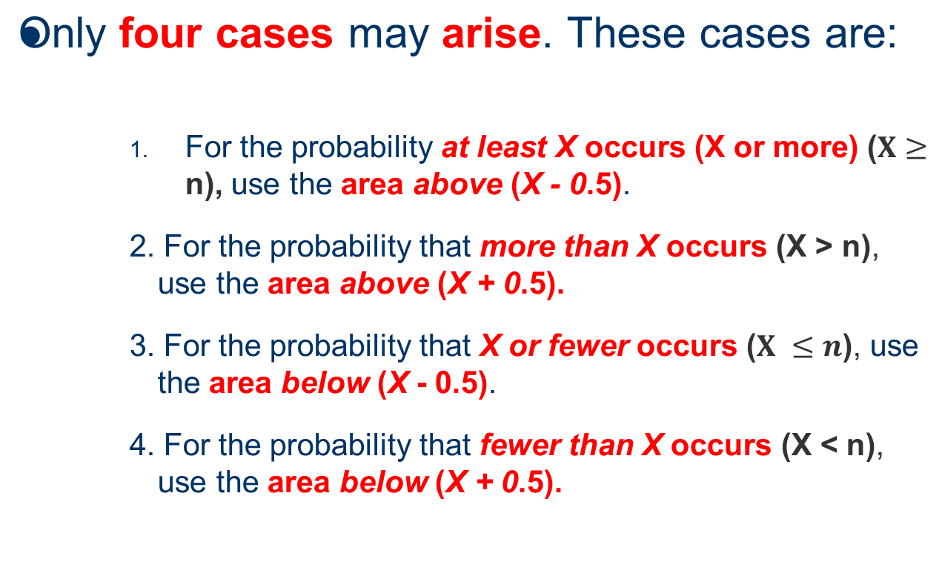
How to Apply the Correction Factor

Slide 51

Normal Approximation to the Binomial - Example
Suppose the management of the Santoni Pizza Restaurant found that 70% of its new customers return for another meal. For a week in which 80 new (first-time) customers dined at Santoni’s, what is the probability that 60 or more will return for another meal?

Slide 52
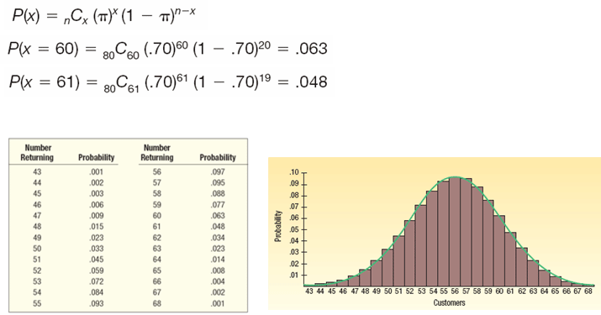
Normal Approximation to the Binomial - Example
P(X ≥ 60) = 0.063+0.048+ … + 0.001) = 0.197

Slide 53
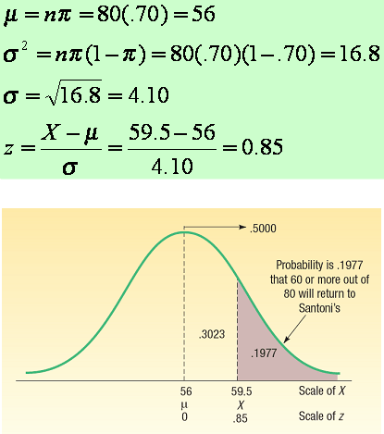
Normal Approximation to the Binomial - Example
Step 1.
Find the mean and the variance of a binomial distribution and find the z corresponding to an X of 59.5 (x - 0.5, the correction factor).
Step 2:
Determine the area from 59.5 and beyond.

Slide 54
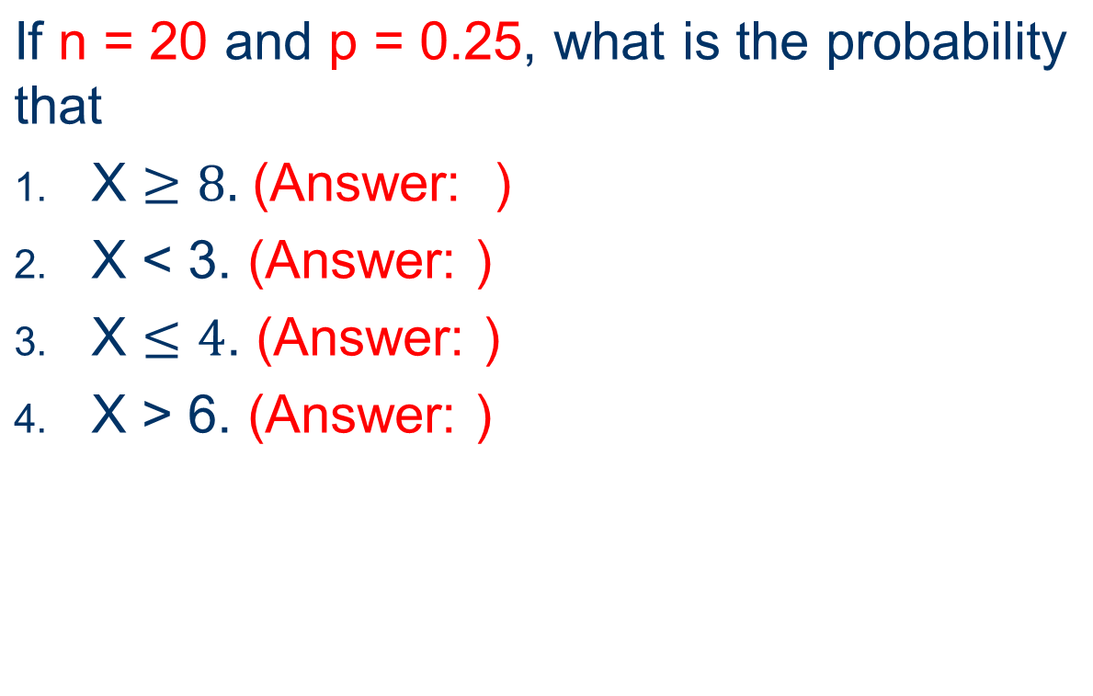
Normal Approximation to the Binomial - Example

Slide 55

End of Week 2

